Slide 1

Application: StyleHive Type: Application Architecture View: Logical View Style: Layered Architecture Pattern
Users
Delivery Channels
Core Business Processes
Data And Information
Technology Enablers
Product Management
User Data
Frontend Technologies
Customer Onboarding and Engagement
Product Data
Backend Technologies
Website
External Users
Pricing and Discount Information
Cloud and Infrastructure
Order Processing and Fulfillment
Third-Party Integrations (Logistics APIs)
Analytics and Metrics
Mobile App (Future Scope)
Advertising and Revenue Generation
Feedback and Reviews
Security (Data Encryption)
Internal Users
Customer Support

Slide 2
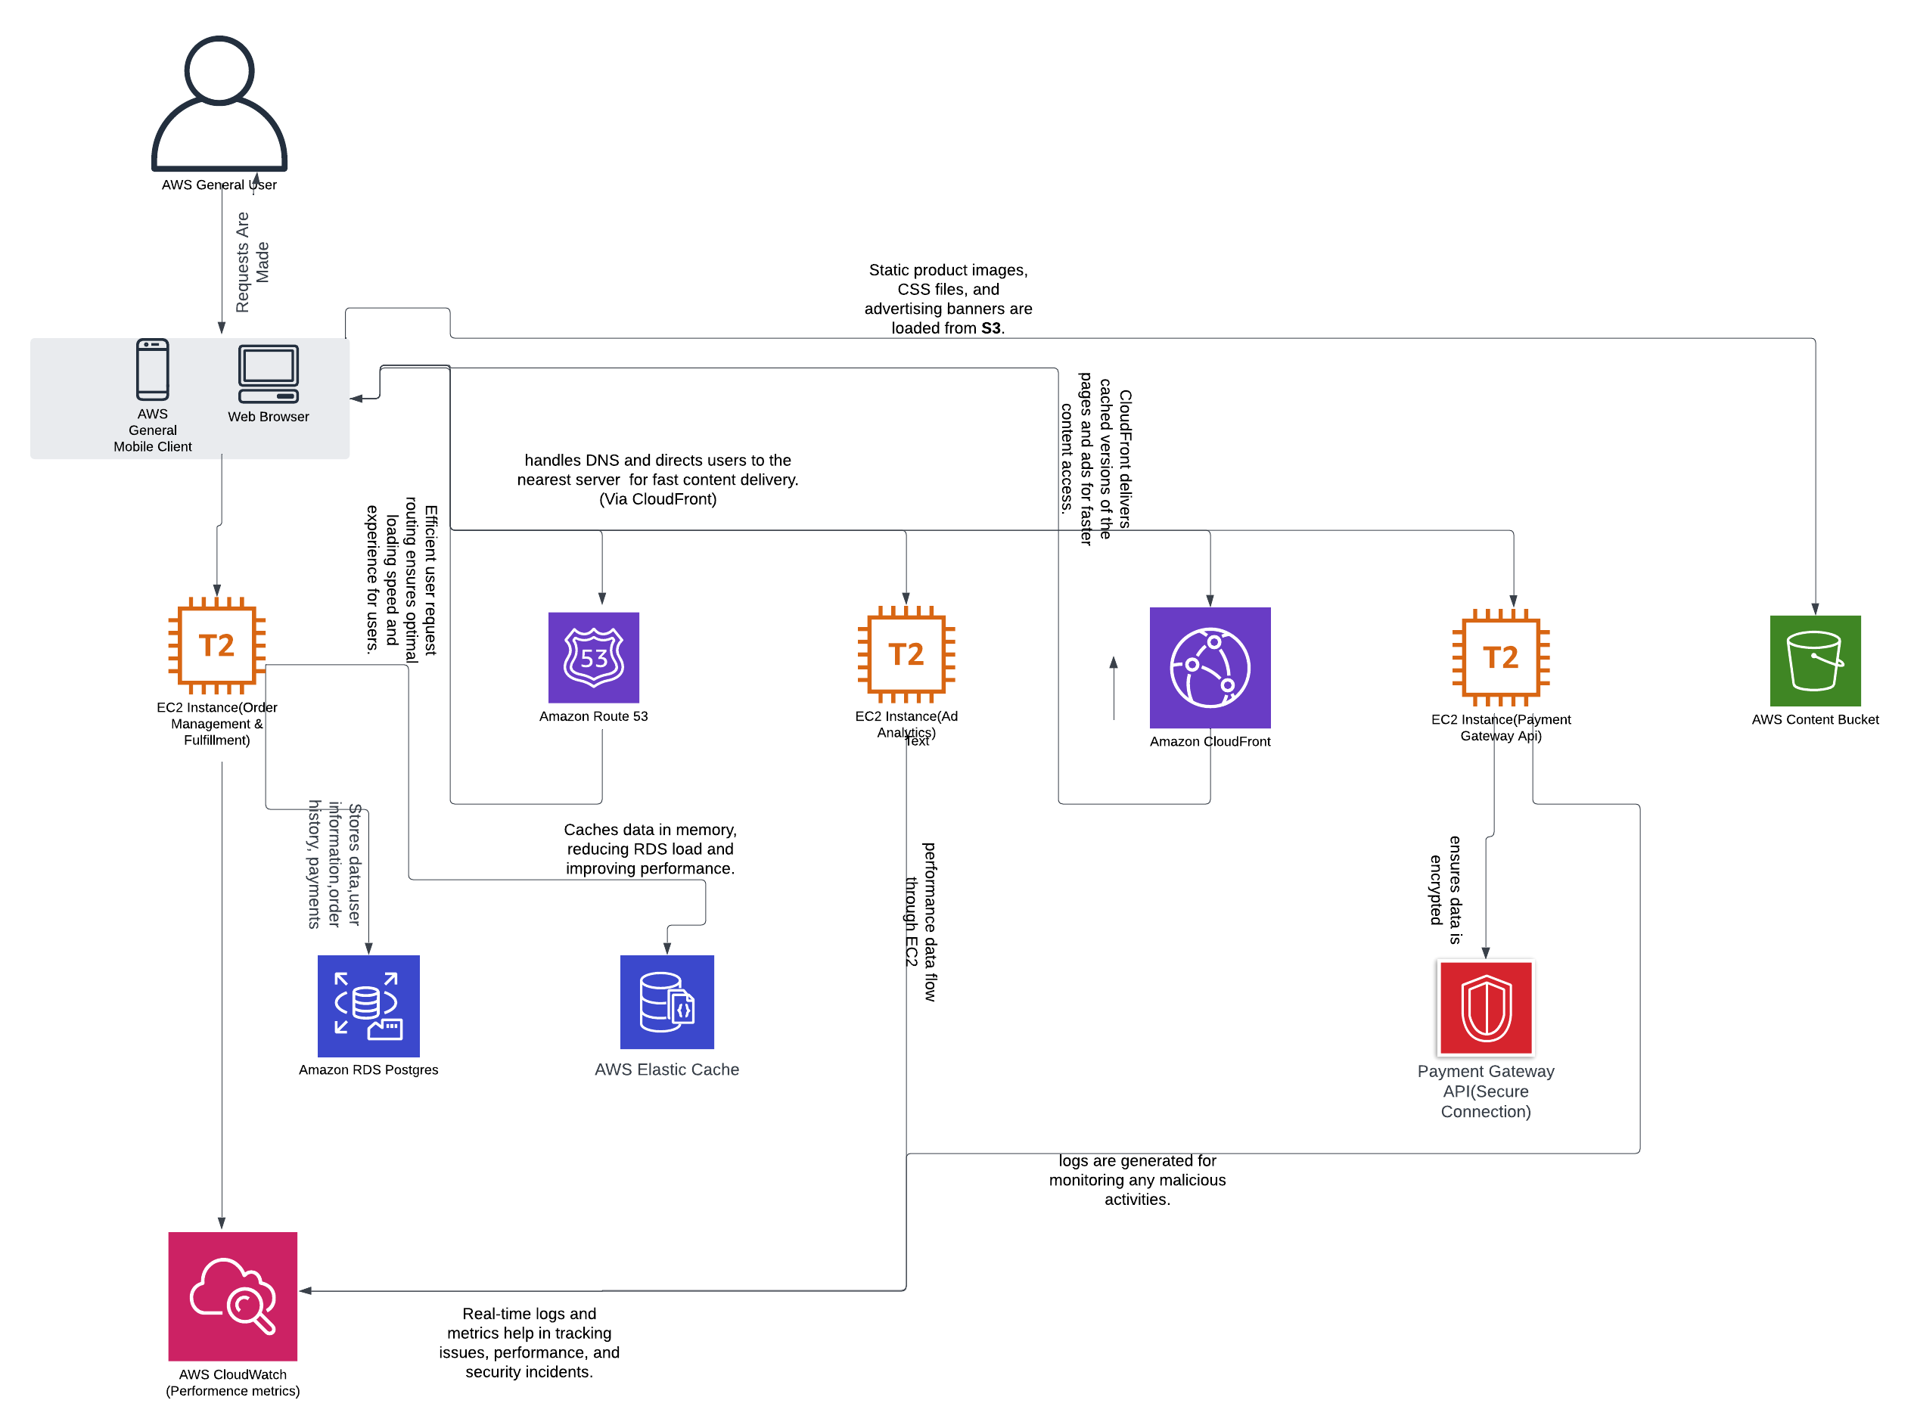
Application: Stylehive Type: Application Architecture View: Process View Style: Client-Server Pattern

